Slide 1


Business Insights 360
Presented By Puranjoy Patra

Slide 2
Agenda
Company Overview
Business Model
Problem statement
Feature Request
Data Source
Data Modeling
Dashboard Overview
Dashboard Presentation
Recommendation
Thanking Note
Goal of this Project

Slide 3
Company Overview
AtliQ Hardware is a global leader in hardware, specializing in PCs, printers, mice, and other computer equipment.
With a strong international presence, they are known for innovative technology and quality products.
Committed to excellence, AtliQ Hardware continues to drive advancements in the tech industry.

Slide 4
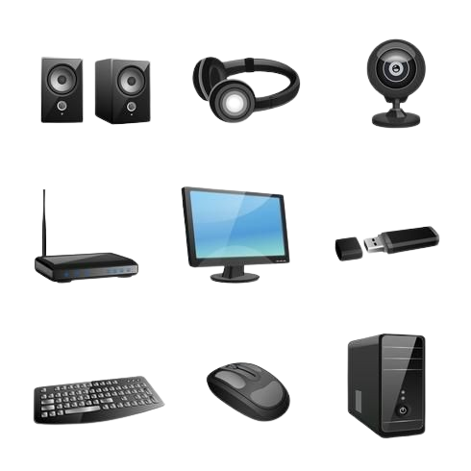






Business Model
Customer
Consumer

Slide 5


Business Model
Channel
Retail
Direct
Distributor
Platform
Brick & Mortar
E-Commerce

Slide 6
Problem statement
AtliQ Hardware is a consumer goods electronics company having operations in various countries. Their business is growing rapidly and they still rely on excel files for data analytics. Excel files are hard to consume and not effective in generating insights. Also due to the lack of effective analytics the company faced a major loss in Latin America.
Senior executives of this company have decided to invest in a data analytics project and have assigned a team for this work.

Slide 7
Goal
This Project is expected to improve the transparency and enable data driven decision-making across markets & functions.
And therefore deliver a quantitative benefit of 10% incremental profit

Slide 8
Features request
Features | Description
Finance View | Show Profit and loss statement to understand financial performance across Markets, Products, Customers etc.
Sales View | Show Top / Bottom Customers along with Key Metrics. A matrix would be preferable to understand their performance.
Marketing View | Same as Sales view but for Products
Supply Chain | Reliability, Forecast Accuracy in a view to understand SC Performance.
Executive View | Integrated view of key insights for executives.

Slide 9
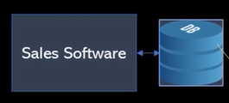

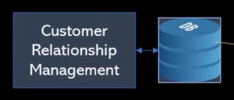



Data Source
There are mainly 2 different sources are used for this Project. From these 2 sources Data is collected to work on it for Analysis.
AtliQ Internal Database
External .xlsx/.csv files
From Fiscal Year 2018 to 2022 for 5 Years Data is taken for this Project.
At AtliQ Fiscal Year starts from September. Last Sales Data is available till Dec 21.
Target data as Benchmark(BM) is available only for Fiscal Year 2022.

Slide 10
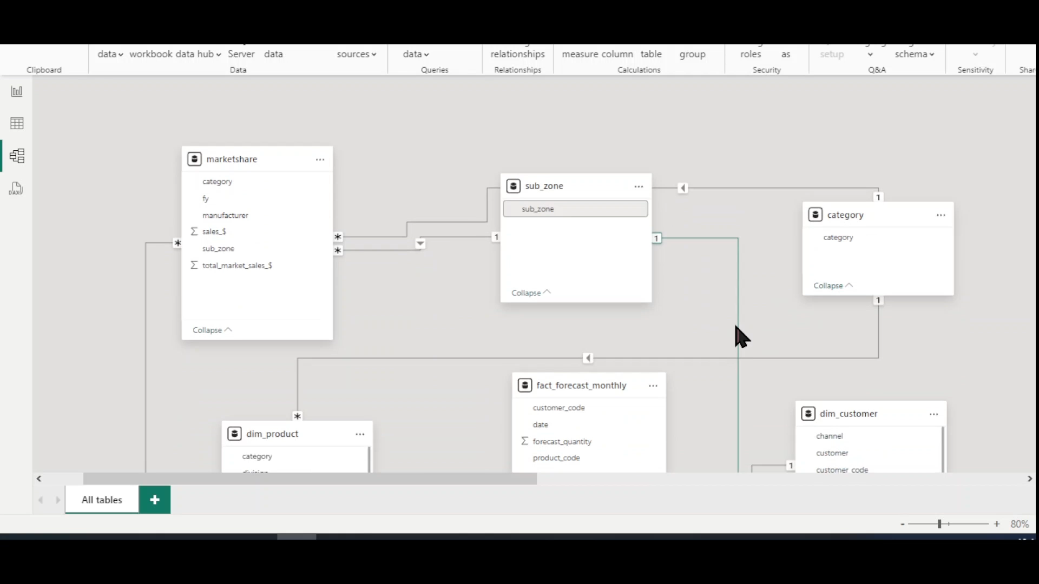
Data Modeling

Slide 11





Dashboard Overview
Finance
Get P & L statement for any customer / product / country or aggregation of the above over any time period and More.
Sales
Analyze the performance of customer(s) over key metrics like Net Sales, Gross Margin and view the same in profitability / Growth matrix.
Marketing
Analyze the performance of product(s) over key metrics like Net Sales, Gross Margin and view the same in profitability / Growth matrix.
Supply Chain
Get Forecast Accuracy, Net Error and risk profile for product, segment, category, customer etc.
Executive
A top level dashboard for executives consolidating top insights from all dimensions of business.

Slide 12
Recommendation
Boost Sales of High Margin Products
Focus on High-Performing Customers
Address Underperforming Segments & Fix Underperforming Products
Reduce Operational Costs
Market Gaming Laptops and Graphic Cards
Monitor and Adapt to Market Changes
Address Excess Inventory (EI) Risks & Reduce Out of Stock (OOS) Incidents
Enhance Cost Efficiency

Slide 13


